Slide 1

Vanguard Initiative regions leading by example in the local energy shift
European Week of Regions and Cities 2023
11.10.2023

Slide 2
Speakers
Gregor Macedoni, Member of the Committee of the Regions, Mayor of the City Municipality of Novo Mesto, Slovenia
Morena Diazzi, Director-General for Knowledge, Research, Labour, Enterprises, Emilia Romagna Region, Italy
Simon Minett, Founder, Challoch Energy, Wales, United Kingdom
Michael Andergassen, Mobility and Transport Manager, Chamber of Commerce of Bolzano/Bozen, Italy
Samo Peter Medved, Deputy Mayor, City of Maribor, East Slovenia
Rainer Gotsbacher, Technopolmanager Wiener Neustadt, Lower Austria
Damon Hewlett, Head of Energy and Climate, Scottish Government Brussels Office, United Kingdom
Janne Rautio, Project Manager, Hydrogen & Circular Economy, Digipolis Ltd., East & North Finland
The session will be moderated by Drasko Veselinovic, Slovenian Business Reserarch Association, VI Board member and co-coordinator of the VI Hydrogen pilot.

Slide 3
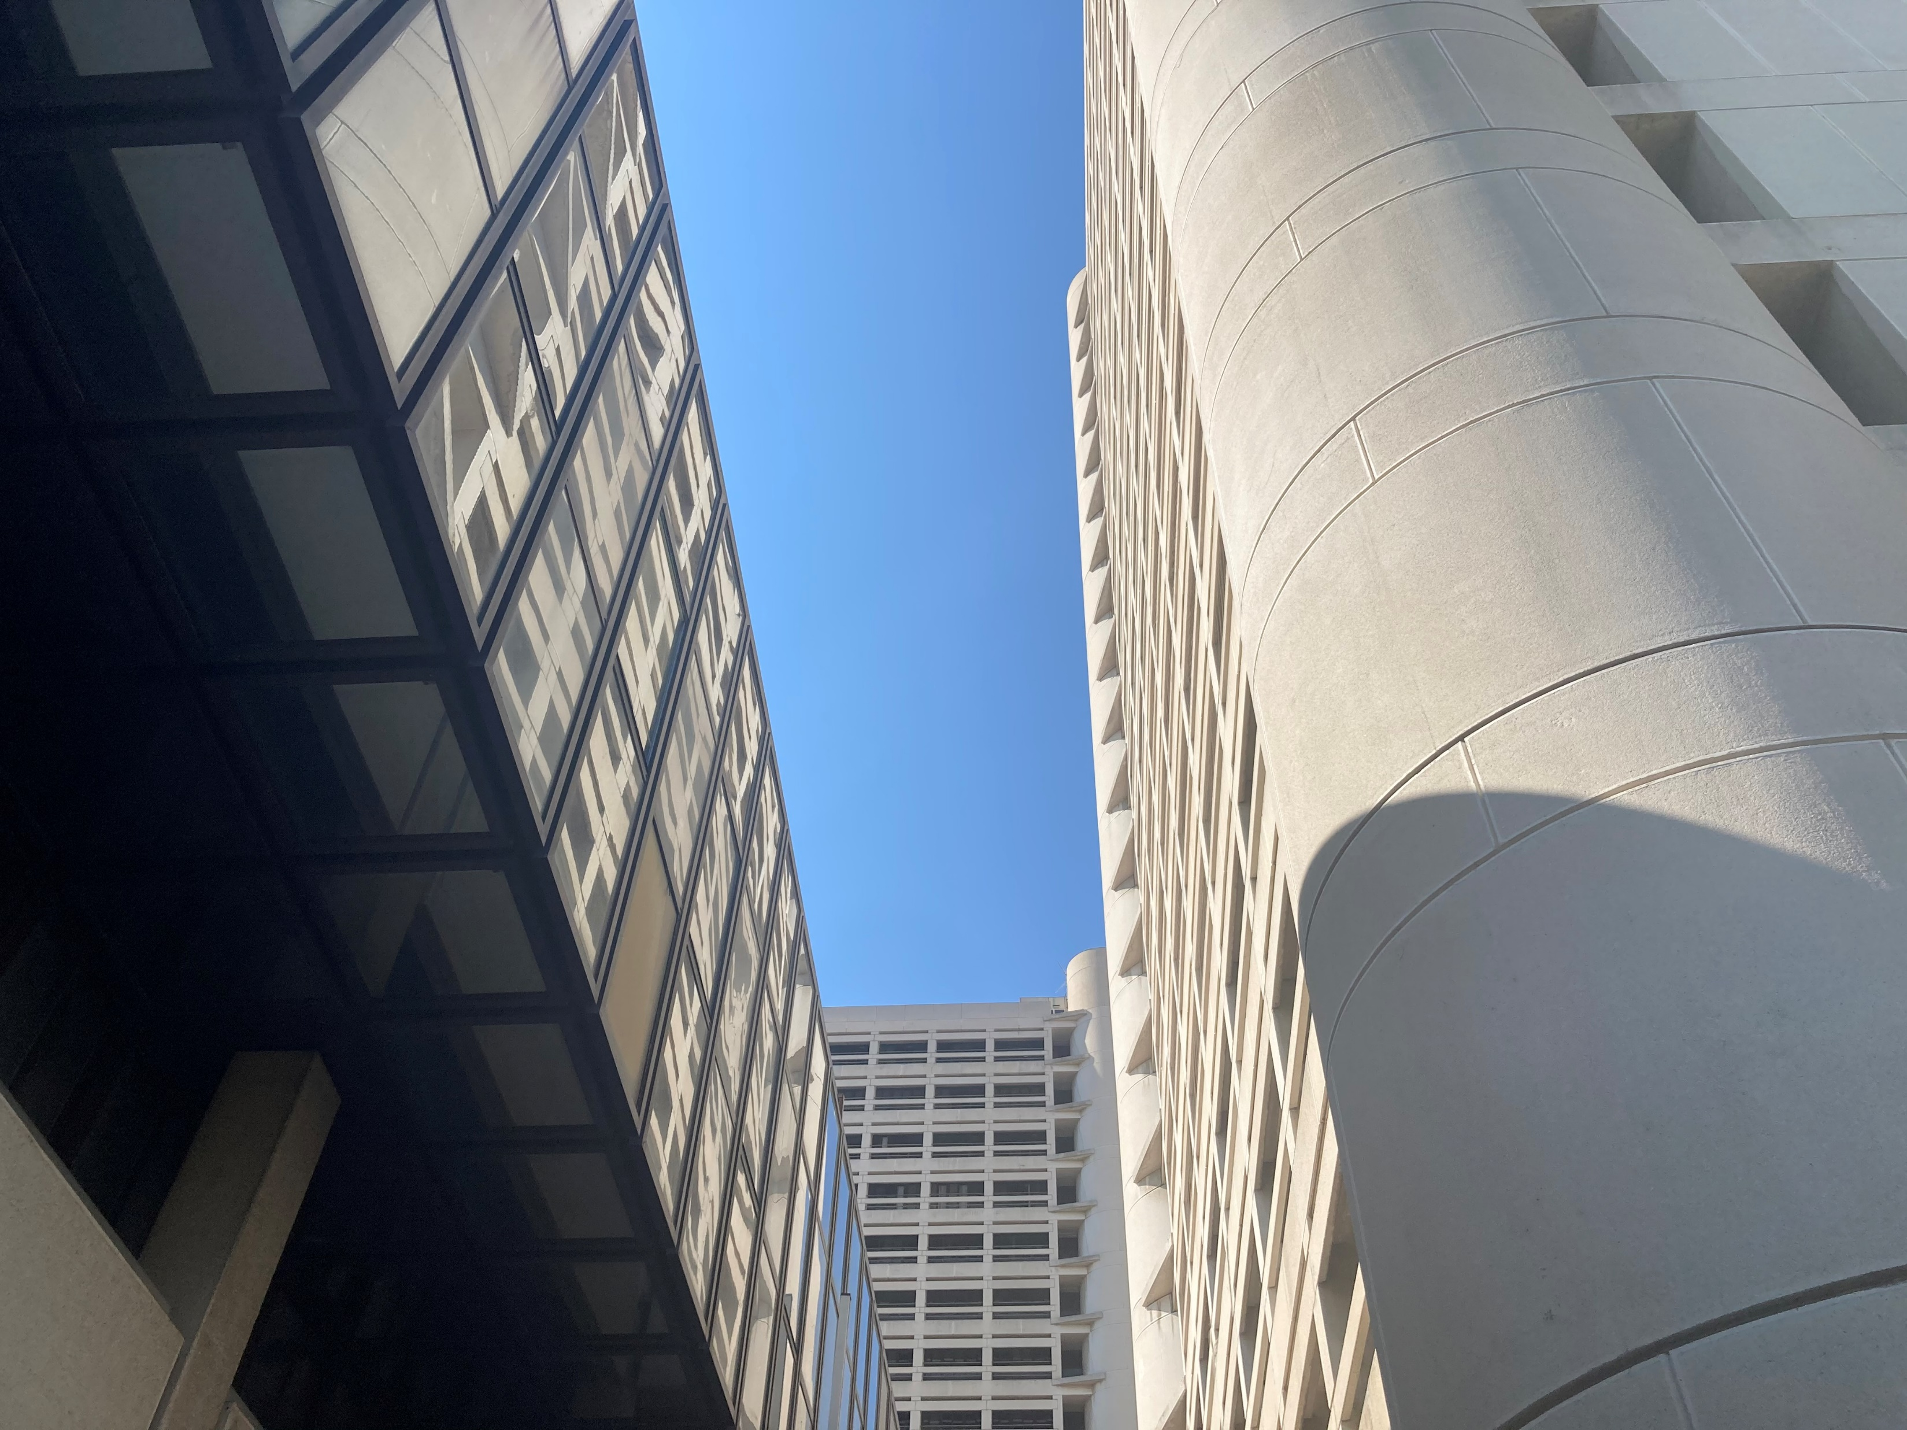




Support for the development of Renewable Energy Communities (RECs) in Emilia-Romagna Region
Director-General for Knowledge, Research, Labour, Enterprises
Ms. Morena Diazzi
Notes:
+

Slide 4

Regulatory framework
the EU Directive known as RED II promotes the increased use of energy from renewable sources as a key tool for combating climate change, protecting the environment and reducing energy dependence, while contributing to job creation and economic growth in the EU
Among the tools put in place by the EU legislator to achieve these goals are Renewable Energy Communities (RECs)
In Italy, the contents of Directive RED II were first partially transposed in 2019, and then fully implemented with the enactment of Legislative Decree No. 199 of November 8, 2021.
the Emilia-Romagna Region approved the Regional Law No. 5 of May 27, 2022 to promote and support the development of such configurations on its territory

Slide 5
Regional Law No. 5 of May 27, 2022 Goals
Increase the amount of energy produced from renewable sources
Improve energy efficiency
Achieve energy independence and autonomy for the Region
Fight energy poverty

Slide 6
Contributions and financial instruments
The contributions and financial instruments under the law are intended to:
Assist the communities in the preparation of plans and documentation related to the establishment of configurations and the purchase and installation of facilities
Support both public entities (such as municipalities, business and trade associations, and energy agencies) and private entities in the implementation of information and citizen participation initiatives on energy matters
Promote and incentivize initiatives for training and improving the skills of local governments also in cooperation with universities and Emilia Romagna’s High Technology Network Laboratories.
In addition to these general forms of support, the law provides for increased subsidies for certain types of energy communities considered to have "strong social and local value."

Slide 7
Other instruments:
Among the tools introduced to promote the creation of RECs in Emilia-Romagna, the Region also:
activated a helpdesk which is dedicated to assisting and informing all citizens and other stakeholders;
is working on publishing a series of Notebooks on the Ecological Transition.
established a permanent technical panel with advisory and propositive functions
conducted a census of the areas and surfaces of public buildings available for the implementation of Communities
dedicated call for support (PR-FESR 2021-2027) for the development of RECs which finances the planning and establishment expenses of the RECs (such as expenses for the technical and economic feasibility study, administrative and legal expenses and so on).

Slide 8
Call for support for the development of RECs
The budget for the call is €2 million from the European structural funds (PR-FESR 2021-2027)
The planned contribution was equal to 80 percent of eligible expenses. This can be further increased by 10 percent up to a maximum of €50,000 if the REC has a strong social and local value.
A total of 141 applications were received to the call and :
  84 of which from local governments/unions of municipalities, 36 from small medium enterprises, 7 from religious bodies, and 14 from individuals;
  for a total capacity of more than 84 MW of photovoltaic to be installed;
  for a total of more than €5 million in estimate resources.
A total of 124 application were judged eligible for a total of €4,9 million.
Next steps are the publication of a new call which will finance the expenses for investment.

Slide 9


Grazie!

Slide 10

H₂
H2 projects in South Tyrol
A focus on mobility

Slide 11
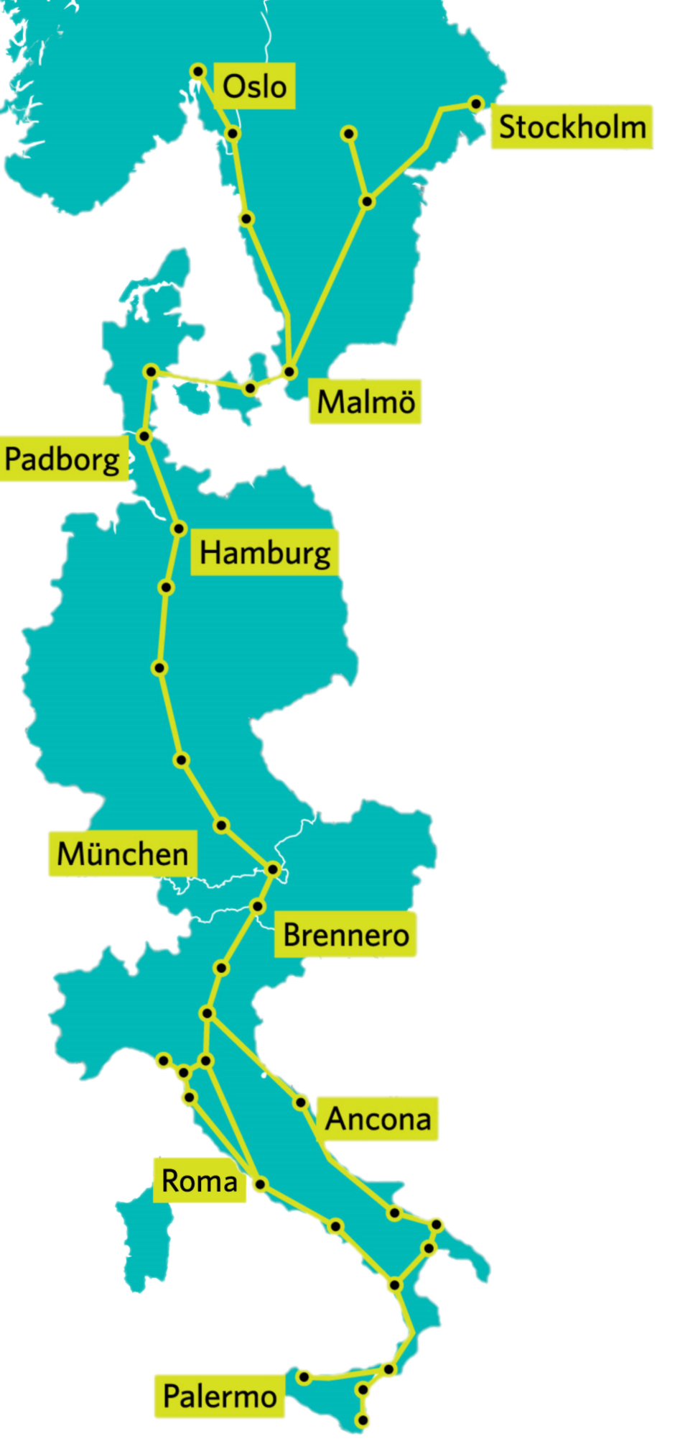


EUROPEAN WEEK OF REGIONS AND CITIES - VANGUARD INITIATIVE REGIONS LEADING BY EXAMPLE IN THE LOCAL ENERGY SHIFT
Why hydrogen?
Climate Plan South Tyrol
Reduce traffic related emissions
  HGVs and public transport)
Winter Olympic Games Milano – Cortina 2026

Slide 12
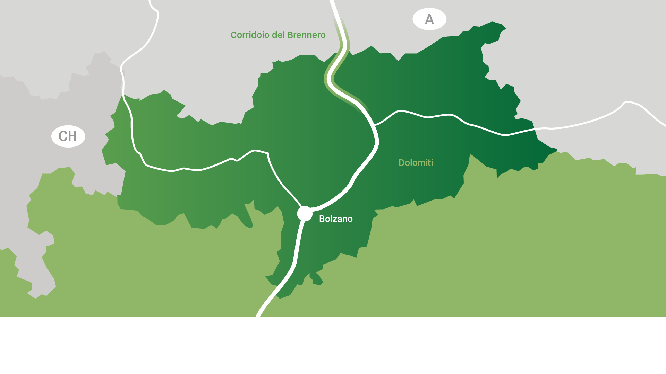


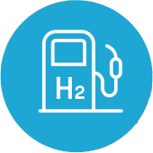

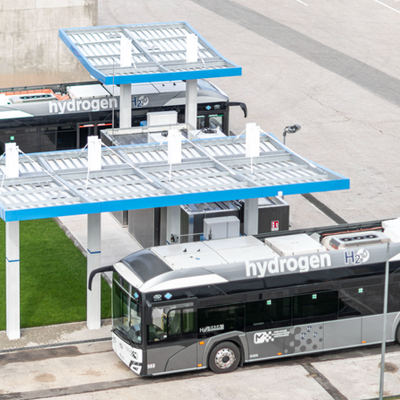

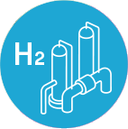

H2 Mobility Projects
in South Tyrol
H2 Fuelling station
H2 Fuelling station
H2 Fuelling station
Hydrogen production
At Bozen / Bolzano

Slide 13
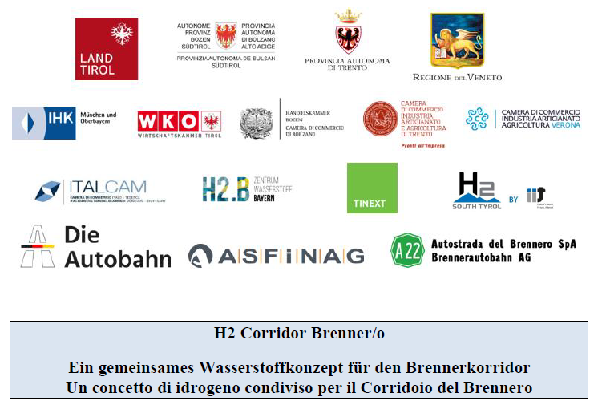
EUROPEAN WEEK OF REGIONS AND CITIES - VANGUARD INITIATIVE REGIONS LEADING BY EXAMPLE IN THE LOCAL ENERGY SHIFT
H2 Corridor Brenner/o
The Brenner as
model corridor for
H2 mobility in Europe?
Cooperation is key!

Slide 14
H2 projects in South Tyrol
A focus on mobility
H₂
Michael Andergassen
Michael.andergassen@provinz.bz.it
Tel. +39 0471 41 25 77

Slide 15


Slide 16
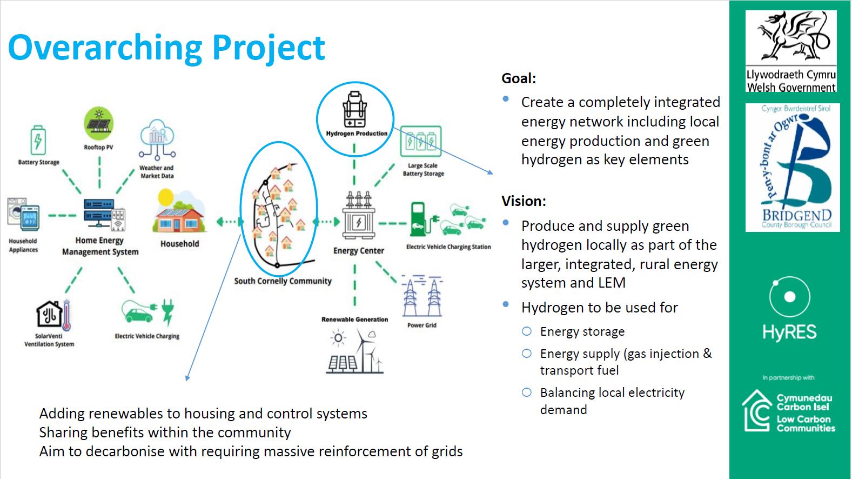

Slide 17
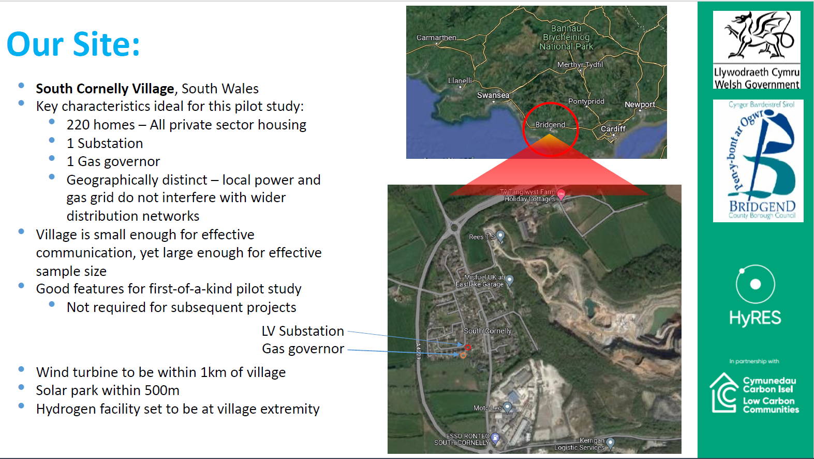

Slide 18
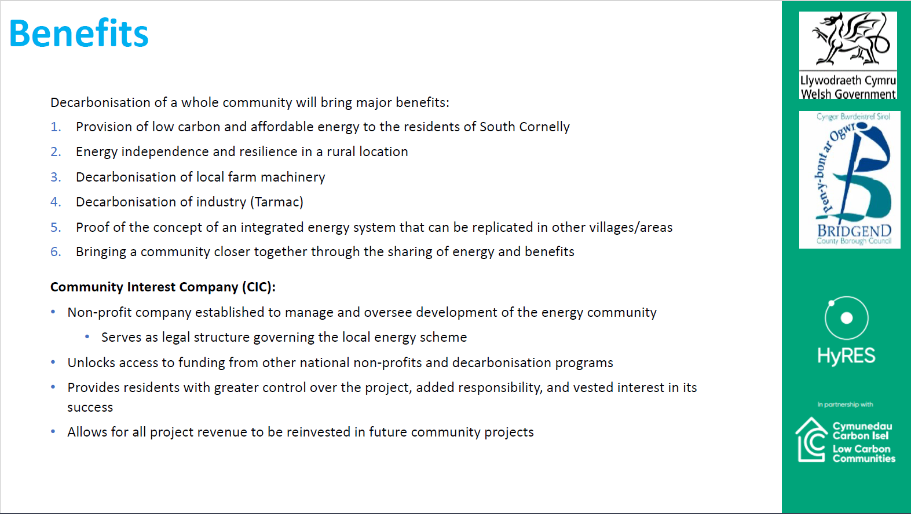

Slide 19


Slide 20


Powering the North
A Clean Energy Revolution in Finnish Lapland
Janne Rautio
Circular Economy Centre

Slide 21
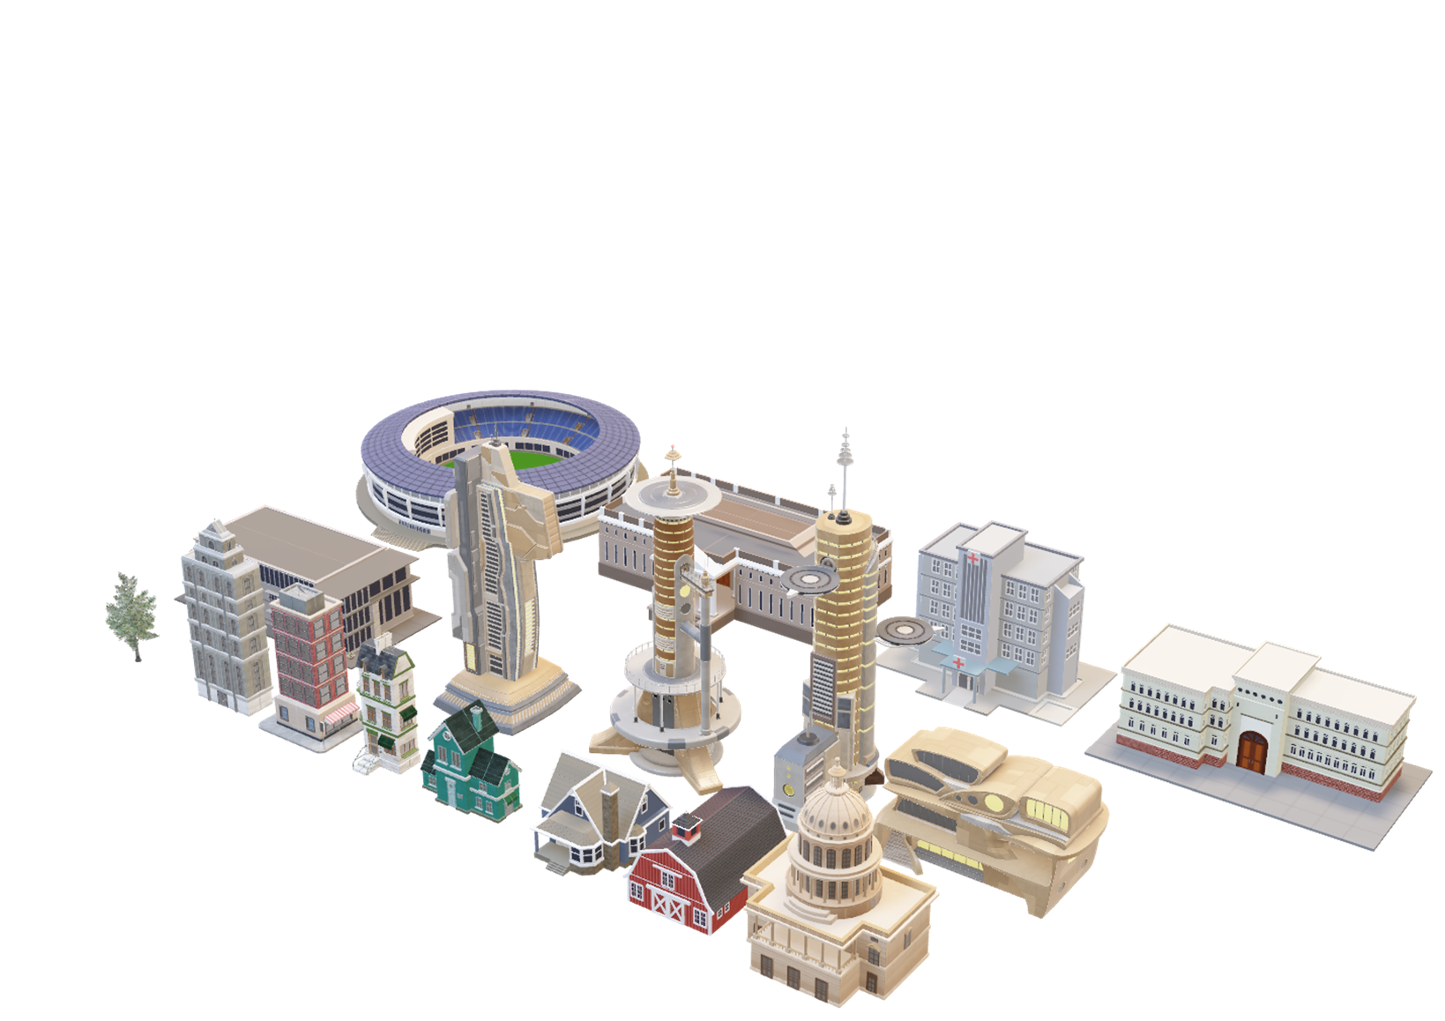
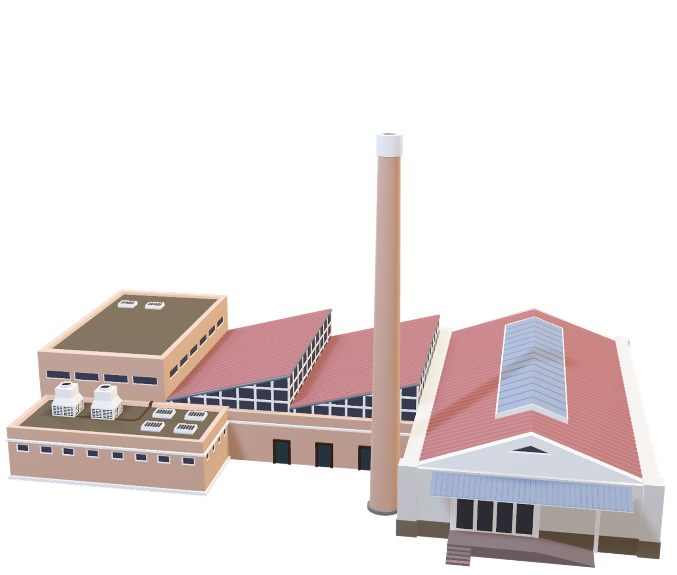






District Heating
Process Heating
District Heating
H₂
N₂
_{P2X}
Hard to abate
CO₂
CO
Biochar

Slide 22
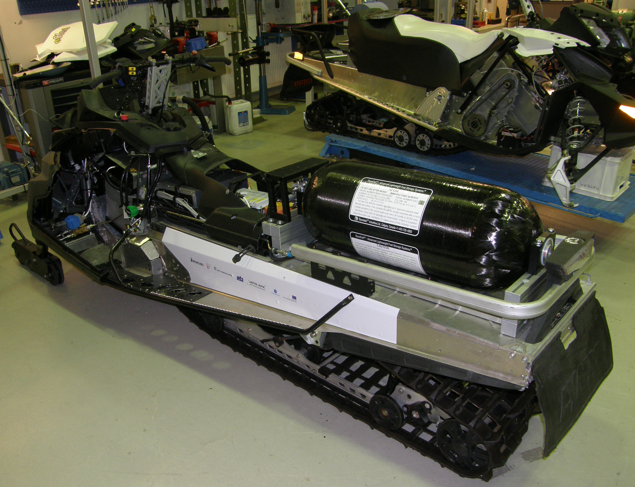
Our strenghts in energy field
Lapland University of Applied Sciences
  3kW electrolyser
  Process automation
  H₂ Storage, Mechanical /Material engineering
  Power grid
  Machine learning and data engineering
Sidestream utilization
Strong industrial SME base

Slide 23

Thank you!
Contact information
Janne Rautio
janne.rautio@digipolis.fi
Tel. +358 40 1961 114

Slide 24

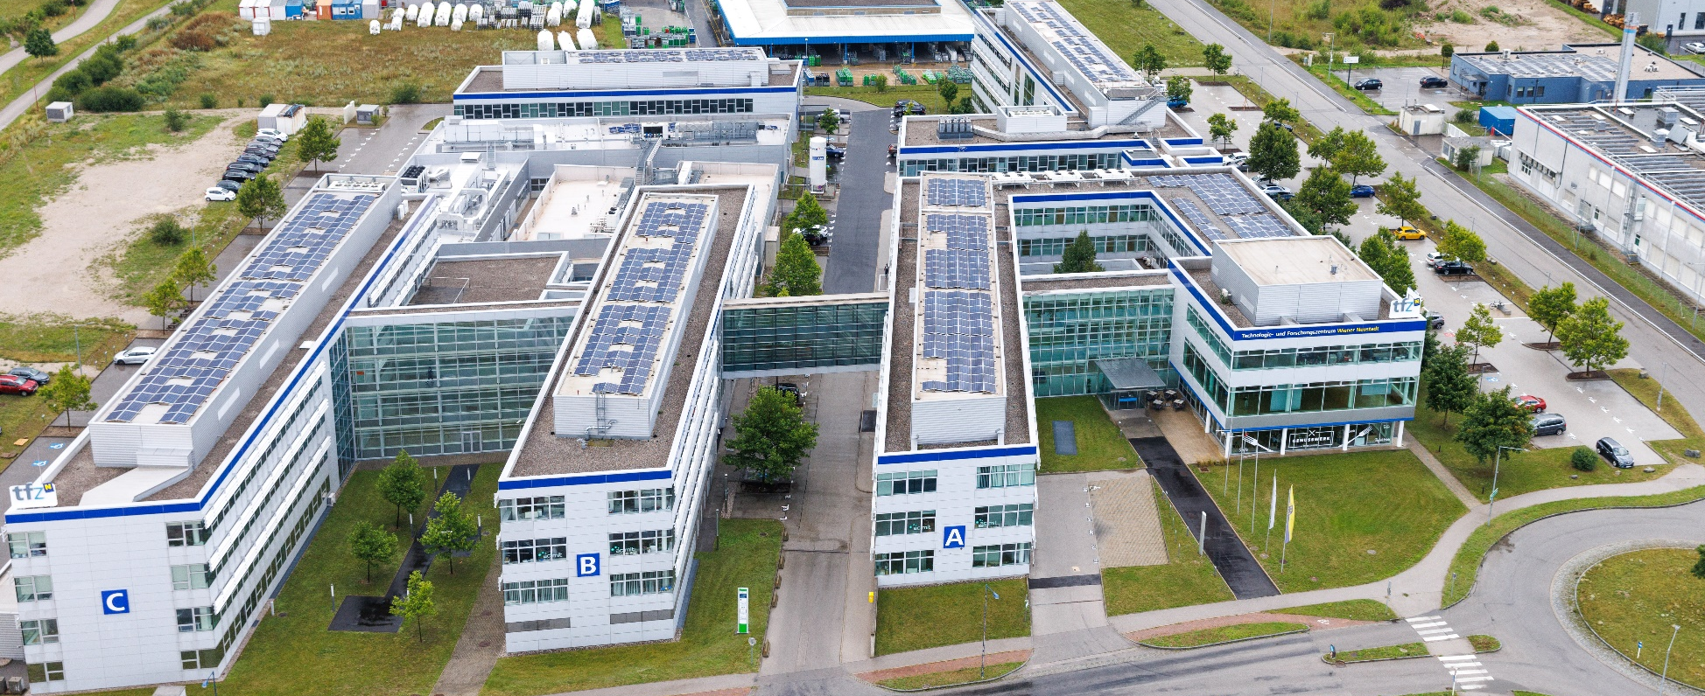
Rainer Gotsbacher, M.Sc.
Technopol Manager
Brussels, 2023

Slide 25
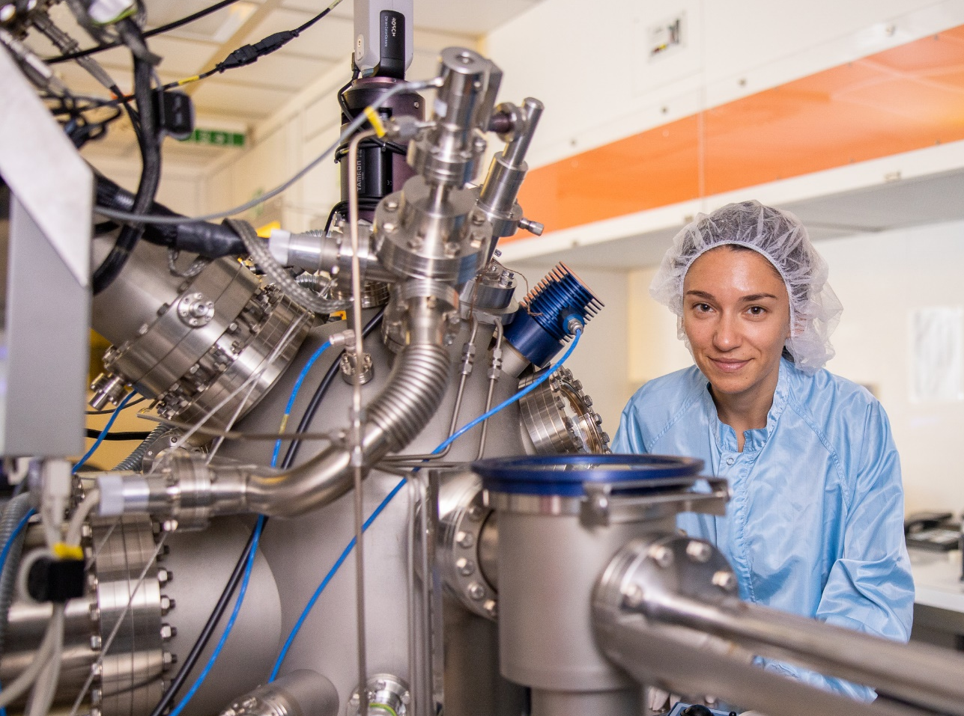
R&D in materials, surfaces and tribology (friction, wear, lubricants) for Hydrogen related R&D Projects in Lower Austria, with Focus on Technopol Wiener Neustadt.
Overview, selected running
and intended Projects.

Slide 26
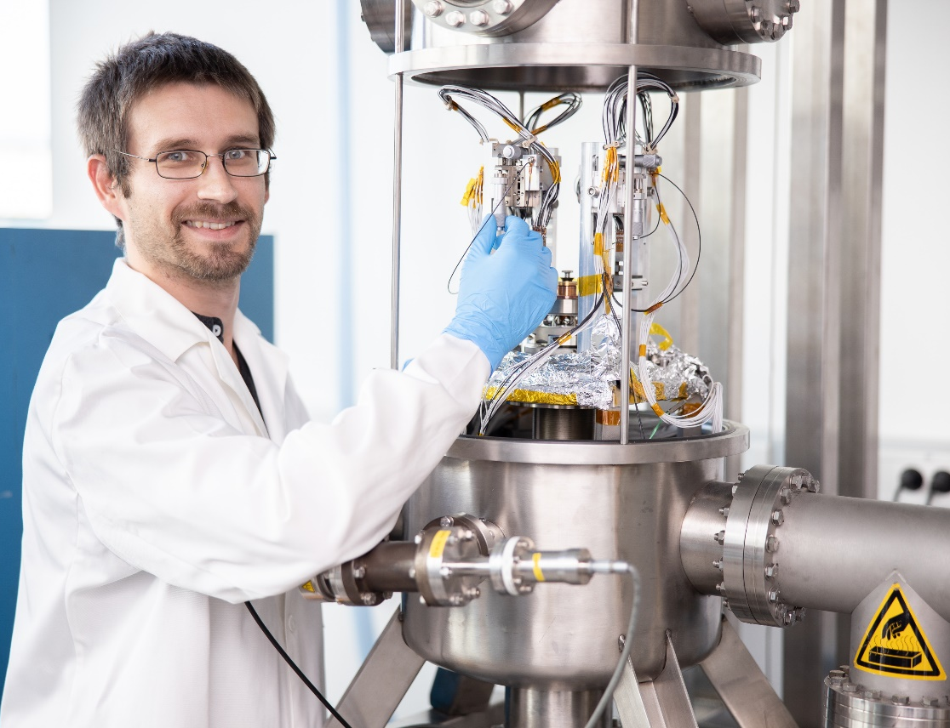
H2NÖ – Hydrogen Initiative Lower Austria,
Focus on 11 Topics
Production of green Hydrogen
Import of climate-neutral H2 +
Hydrogen for Technology-Parks
Hydrogen Valley Lower Austria
Sustainable Aeronautics Fuels
CO2 free truck transport of cargo
Hydrogen usage in Industry
Export of Hydrogen Technologies developed in Lower Austria
Public Opinion
Simplification of approval procedures
Creation of human ressources

Slide 27
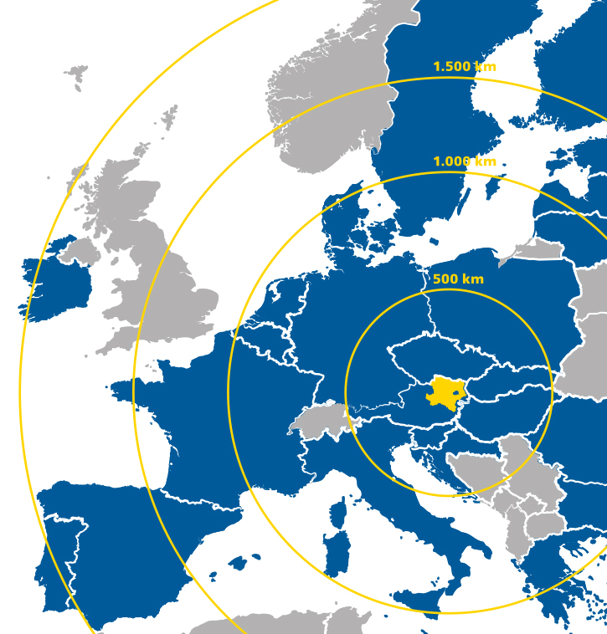
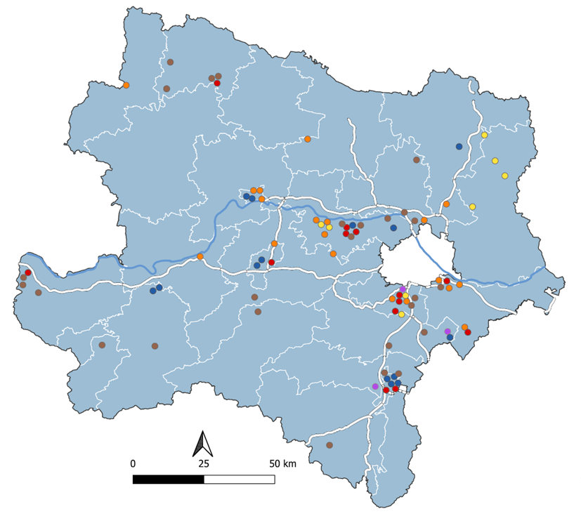
Lower Austria – Hydrogen activities (R&D, Industry,..)
Notes:
Wiener Neustadt
Selected Key Facts
Total area: 60,9 km²
Population: 45.000
Founded: 1194
2-nd largest City in Lower Austria
Two Airfields
Education, Research & Hightech
Oldest „University of Applied Sciences“ in Austria

Slide 28
R&D & High-tech Companies on Site, e.g.
AC2T R&D Centre of Excellence in Tribology
CEST R&D Centre for Electrochemical Surface Technology
FHWN University of Applied Science Wr. Neustadt
FOTEC Research & Technology-Transfer ltd.
DISS Department for Integrated Sensor Systems, Danube University Krems
AAC Aerospace and Advanced Composites ltd.
RHP technology / Attophotonics Powder technology, Additive Manufacturing, Smart materials & surfaces
Diamond Aircraft Industries R&D and production of piston aircraft models
Austro Engine Innovative solutions in jet fuel piston engines well as of rotary engines
IEG Institut for electrochemistry, electroplating and Materials-Chemistry

Slide 29
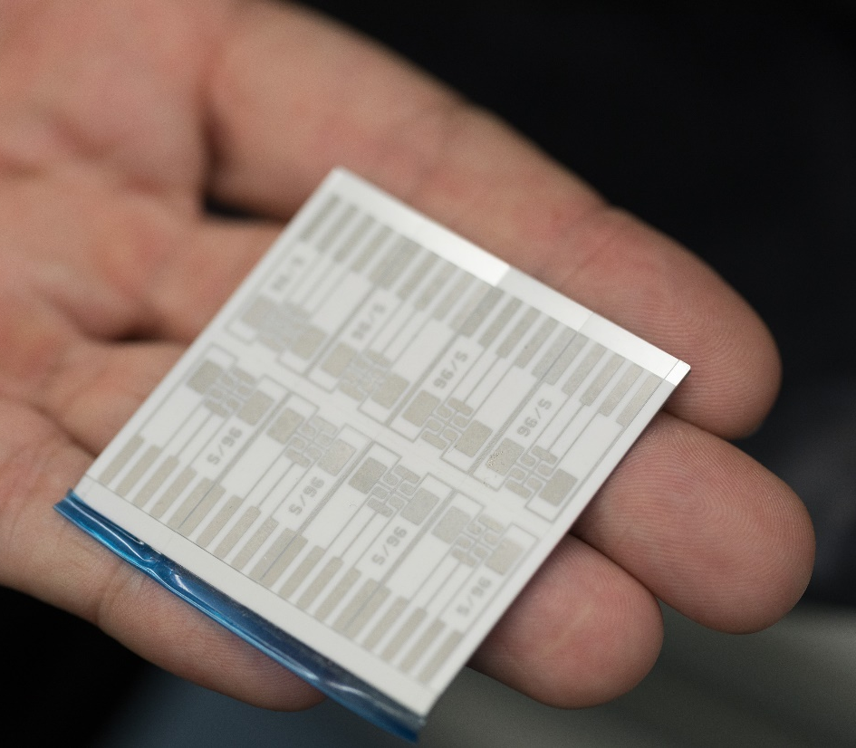
Running & intended Projects, e.g.
H₂ direct combustion - pistion engines
H₂ power train (storage, fuel cell, batteries,…) for Aeronautics
Determination of gas proofness, mechanical and tribological behaviour under cryogen conditions
Digital twin for development of liquid hydrogen storage for aeronautic applications
3D printed components R&D, digital twin, test facilites
ECAP to improve H₂ Storage in Magnesium
Manufactoring of components made by Poder Injection Moulding for
Hydrogen valve housings/connectors etc.
Compact Multi-Channel Components for pressure regulation systems
R&D of H2 Sensors and Sensor-Systems/Networks
Development of gas proove pipe connections
LH2L Liquid Hydrogen Lab for Hydrogen Applications
Notes:
LH₂L Liquid Hydrogen Lab: Exzellenzknotenpunkt für Flüssigwasserstoff-Anwendungen in NÖ
Technologiezentrum zur Entwicklung und Validierung von Komponenten und Systemen für den klimaneutralen Flugverkehr

Slide 30
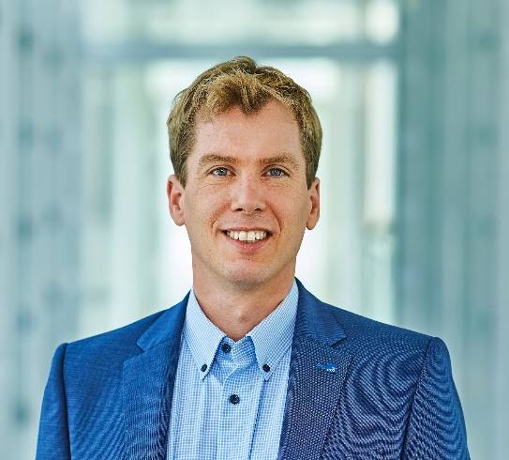
Rainer Gotsbacher, M.Sc.
Technopolmanager Wiener Neustadt
Viktor Kaplan Street 2
2700 Wiener Neustadt
ecoplus. The Business Agency of Lower Austria
Tel:. +43 664 8482684
r.gotsbacher@ecoplus.at
www.ecoplus.at
www.technopol-wienerneustadt.at

Slide 31


Vanguard Initiative Regions leading by
example in the local Energy shift
MUNICIPALITY OF MARIBOR
Dr. Samo Peter Medved, Deputy Mayor samopeter.medved@maribor.si
EU Regions of Week 2023, Brussels

Slide 32

Air Quality in Maribor
Sulfur dioxide SO2
With the abolition of coal as an energy source and the transition to extra light fuel oil, natural gas and district heating, PM₁₀ particles have been significantly reduced.
SO2 measurements are no longer carried out in Maribor, as concentrations fell below the daily limit value (125μg/m³) years ago due to the abandonment of coal.
Notes:
AIR
With the abolition of coal as an energy source and the transition to extra light fuel oil, natural gas and district heating, PM₁₀ particles have been significantly reduced.
In recent years, particulate concentrations have continued to decline as renewables are being introduced as a priority.
Between 2001 and 2022, the highest measured concentration was 58μg/m³ and the lowest was 22 μg/m³.
SO2
SO2 measurements are no longer carried out in Maribor, as concentrations fell below the daily limit value (125μg/m³) years ago due to the abandonment of coal.
Measurements were carried out until 2012.
The overall strengths prescribed in the Ordinance on the air quality plan for Agglomeration Maribor and the Municipal Environmental Protection Programme 2021-2030 contributed to improving air quality in the city.
Due to air quality improvement, the Government of the Republic of Slovenia abolished the Ordinance in March 2022.

Slide 33
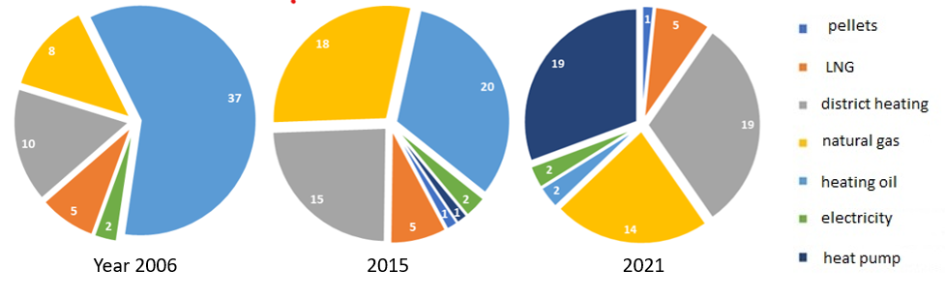
The city's energy transition from coal to heating oil, natural gas to cleaner energy sources
30 years ago, the city made a significant shift in its energy policy, transitioning from coal to the use of extra-light heating oil. In all sectors, coal was mostly replaced by oil. As a result, the air quality in the city significantly improved.
Construction of the natural gas pipeline network in 1978 and the district heating network in 1984, the use of extra-light heating oil was gradually abandoned, both in larger boiler rooms (transitioning to district heating) as well as in individual residential units (transitioning to natural gas).
Energy shift in heat consumption in public buildings (primary schools, kindergartens and administrative municipal building) – Number of buildings by type of energy source for the years 2006, 2015 and 2021
Notes:
The city's energy transition from coal and later heating oil to cleaner energy sources
Thirty years ago, the city made a significant shift in its energy policy, transitioning from coal to the use of extra-light heating oil. In all sectors, coal was mostly replaced by oil. As a result, the air quality in the city significantly improved.
With the commencement of the construction of the natural gas pipeline network in 1978 and the district heating network in 1984, the use of extra-light heating oil was gradually abandoned, both in larger boiler rooms (transitioning to district heating) as well as in individual residential units (transitioning to natural gas). This transition occurred in line with the expansion of both networks.
Graphical representation illustrating the transition to cleaner heating sources (natural gas, district heating, heat pumps) and the decreasing trend in the use of ELKO in the case of public and multi-apartment buildings (large boiler rooms) for which energy monitoring is conducted.
From the above graphs, a significant decrease in the use of heating oil and a big increase in the use of heat pumps in combination with a peak boiler (mostly on natural gas) in 2021 compared to 2006 is evident. In addition to heat pumps, district heating is most used for heating in public buildings in 2021, followed by natural gas.

Slide 34
From Local Energy Concept to of Maribor 2009 the Local Energy and Climate Concept of Maribor 2021
The transition policies towards a climate-neutral society are most prominently realized at the local level, which is why municipalities and local communities are key actors in implementing climate-neutral transition measures.
Maribor is actively working towards reducing energy consumption in the city and introducing renewable energy sources (RES), especially in the public sector. In 2009, the first Local Energy Concept of Maribor (LEK MOM) was adopted by the City Council, which defined ten comprehensive long-term goals for reducing energy consumption and introducing RES, along with an action plan for implementation. In 2021, the Maribor City Council approved the Local Energy and Climate Concept of Maribor (LEPK MOM), a document that not only focuses on climate change mitigation (including energy efficiency and RES to achieve climate neutrality) but also places significant emphasis on adapting to climate change.
Notes:
The trend of reducing the use of heating oil in multi-apartment buildings of the Municipality of Maribor (large boiler rooms)
The transition policies towards a climate-neutral society are most prominently realized at the local level, which is why municipalities and local communities are key actors in implementing climate-neutral transition measures.
Maribor is actively working towards reducing energy consumption in the city and introducing renewable energy sources (RES), especially in the public sector. In 2009, the first Local Energy Concept of Maribor (LEK MOM) was adopted by the City Council, which defined ten comprehensive long-term goals for reducing energy consumption and introducing RES, along with an action plan for implementation. In 2021, the Maribor City Council approved the Local Energy and Climate Concept of Maribor (LEPK MOM), a document that not only focuses on climate change mitigation (including energy efficiency and RES to achieve climate neutrality) but also places significant emphasis on adapting to climate change.

Slide 35
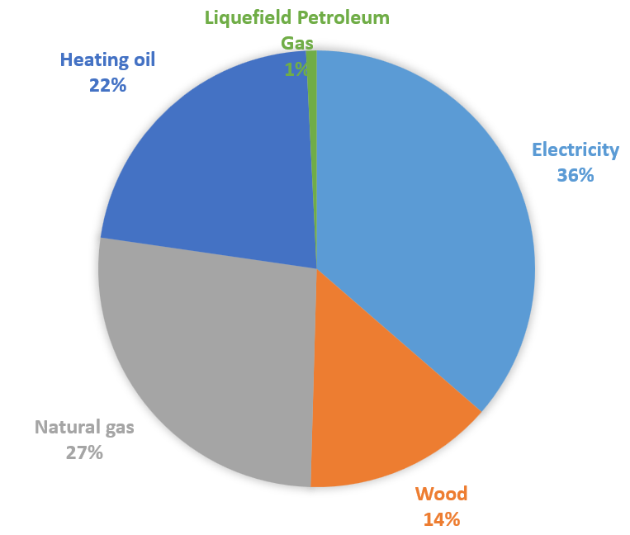
Energy consumption in Municipality of Maribor – heat and electricity
Source: Local energy and climate concept – LEPK MOM, 2021
Notes:
Energy consumption in Municipality of Maribor – heat and electricity

Slide 36
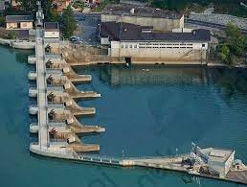
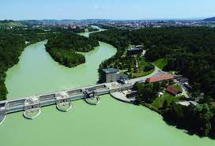
Generated and consumed electricity
- 73 % of all electricity consumed in the municipality was produced within the municipality's territory
- 77 % of the produced electricity comes from renewable sources (hydropower and PV)!
Notes:
Generated and consumed electricity
Production source for electricity in the Municipality of Maribor for the year 2021
Ratio between generated and consumed electrical energy in Municipality of Maribor (kWh)
In 2021, 73 % of all electricity consumed in the municipality was produced within the municipality's territory 77 % of the produced electricity comes from renewable sources (hydropower and PV).

Slide 37
Projects in progress for district heating network
High-temperature heat pump water-to-water (Qht ≈ 2,0 MW)
  River Drava as thermal energy source,
  self-sufficiency – HP drive with its own PV and CHP,
  Expected launch in September 2023,
  12.000 MWh of green energy
  Project without financial incentives.
Wood-biomass boiler (Qht ≈ 5 MWht )
  Local energy source,
  using energy storage to optimize production,
  15.000 MWh of renewable energy
  application for a tender for co-financing.
Heat storage tanks
  Optimization of heat production
  Peak load shaving
Notes:
Projects in progress
High-temperature heat pump water-to-water (Qht ≈ 2,0 MW)
River Drava as thermal energy source,
self-sufficiency – HP drive with its own PV and CHP,
Expected launch in September 2023,
12.000 MWh of green energy
Project without financial incentives.
Wood-biomass boiler (Qht ≈ 5 MWht )
Local energy source,
using energy storage to optimize production,
15.000 MWh of renewable energy
application for a tender for co-financing.
Heat storage tanks
Optimization of heat production
Peak load shaving

Slide 38
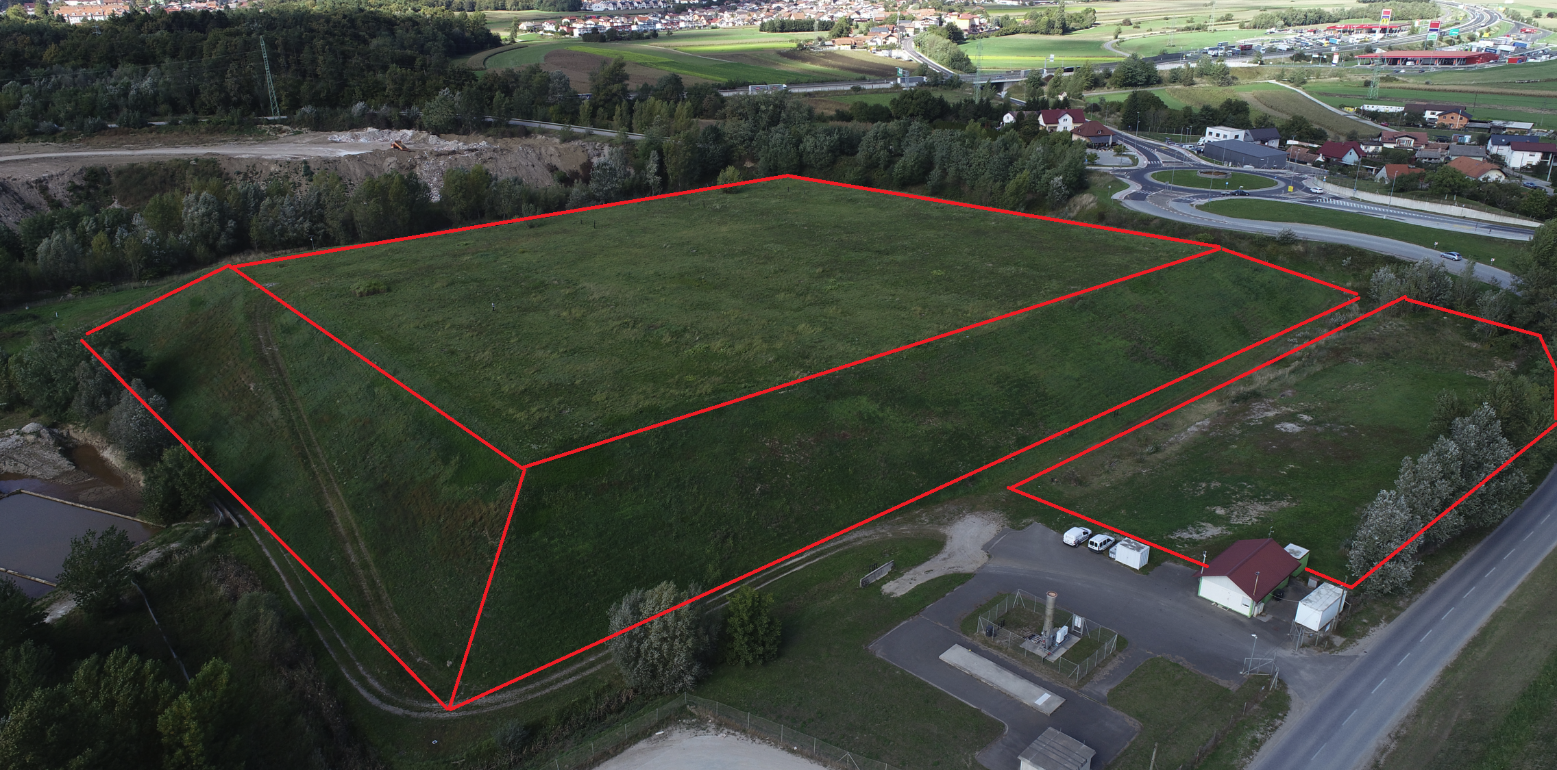
Solar power plants
A clearly outlined vision of MOM in the areas of:
  self-sufficiency,
  exploitation of degraded areas,
  electrification of transport,
  management of energy flows:
  consumption <-> production <-> storage.
Project in progress, phased implementation:
Solar power plant Pobrežje - 10 MW in 2025
Annual production: 12.265 MWh
Annual CO2 savings: 6.500 tons
Solar power plant Dogoše - 2 MW in 2026.
Annual production: 2.450 MWh of electricity
Annual CO2 savings: 1.900 tons
Solar power plants on public schools in the city of Maribor
Total installed power of the PVs: 1,075 MW
Annual PVs production: 1.165 MWh
Annual energy consumption of schools: 1.175 MWh
Annual CO2 savings: 570 tons
VISION to become carbon-neutral by 2040
All the projects contribute to the decarbonization in Maribor.
CO2 savings with biomass boiler, waste to energy and heat pump: 21.000 tons/year.
CO2 savings with Solar power plants: 8.970 tons/year.
Our vision is to pursue these ambitious goals to ensure and enhance the quality of life in the Municipality of Maribor while creating opportunities for innovation, employment, and green growth.
Notes:
Solar power plants
A clearly outlined vision of MOM in the areas of:
self-sufficiency,
exploitation of degraded areas,
electrification of transport,
management of energy flows:
consumption <-> production <-> storage.
VISION
The Municipality of Maribor has set a target of becoming carbon-neutral by 2040.
All the projects contribute to the decarbonization in Maribor.
CO2 savings with biomass boiler, waste to energy and heat pump: 21.000 tons/year.
CO2 savings with Solar power plants: 8.970 tons/year.
This means striving to improve energy and material efficiency, increasing the share of RES, both of which will significantly reduce CO₂ emissions. At the same time, the municipality will maintain or enhance carbon sinks and work towards increasing climate resilience.
These goals will be achieved through the modernization of buildings and public infrastructure, the continued phasing out of fossil energy use, and the adoption of new renewable technologies. Furthermore, the municipality will promote environmentally friendly modes of mobility, engage in sustainable forest and ecosystem management, and introduce green infrastructure and other modern climate-adaptive planning practices.
Our vision is to pursue these ambitious goals to ensure and enhance the quality of life in the Municipality of Maribor while creating opportunities for innovation, employment, and green growth.

Slide 39
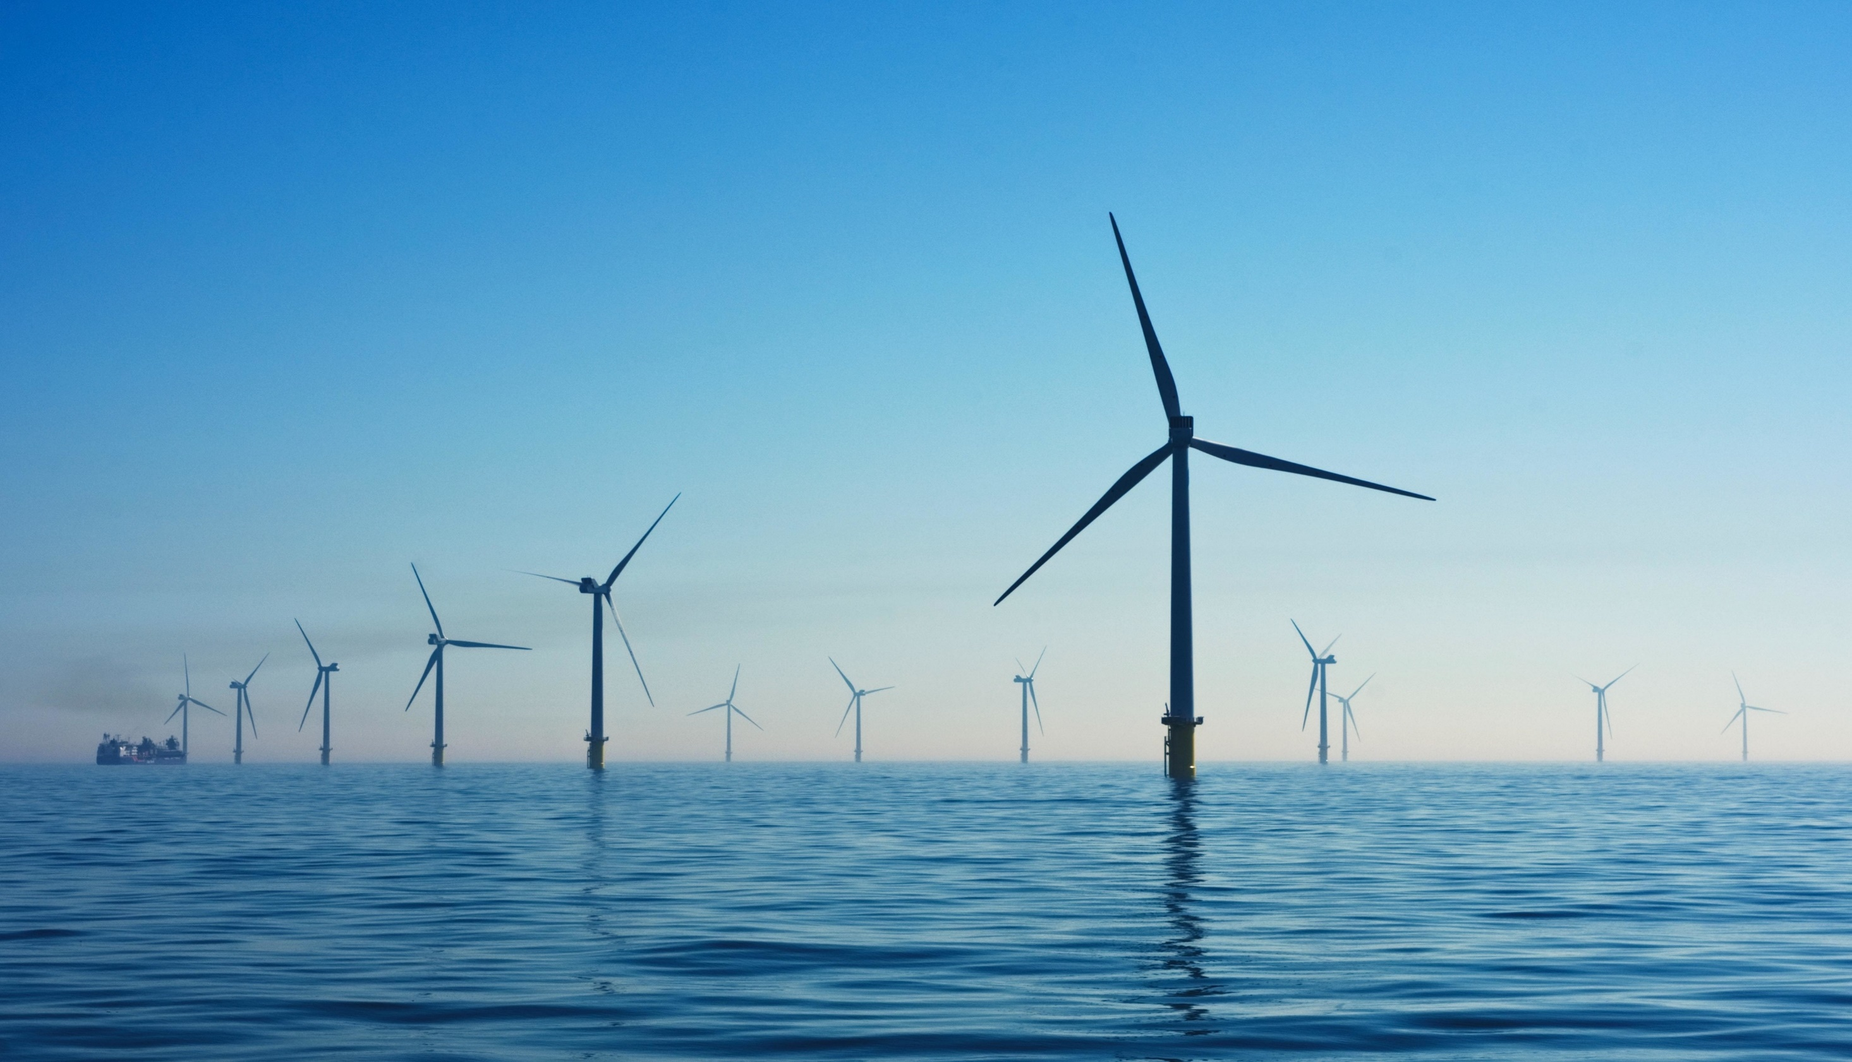

Scotland’s offshore renewable energy journey
Damon Hewlett, Scottish Government – Scotland House Brussels
Vanguard: Local Energy Shifts Event, European Week Regions and Cities
11 October 2023

Slide 40
Overview
Aim:
To illustrate Scotland’s renewable energy progress and plans and the role international collaboration can play in reaching our ambitions.
Structure:
Scotland’s offshore wind potential
Link to hydrogen export ambitions
International collaboration

Slide 41
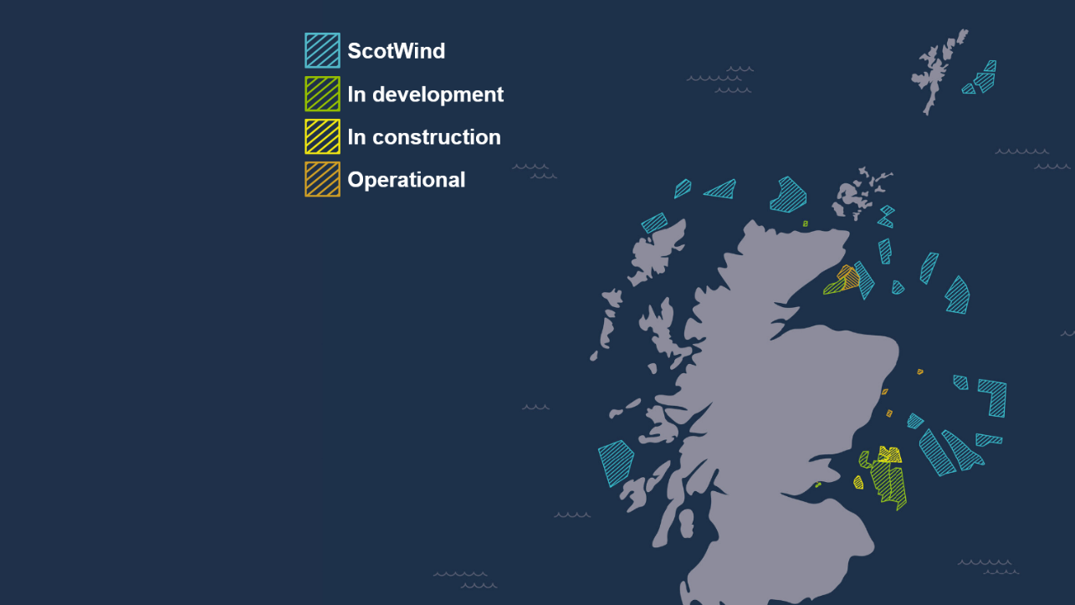


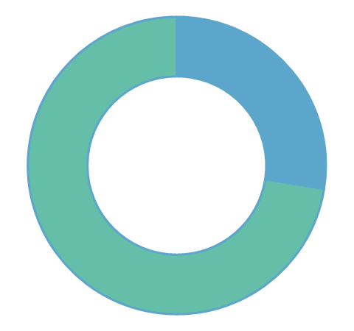
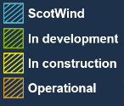
Scotland’s offshore wind pipeline
Over 38 GW*
Scotland’s offshore wind pipeline
Around 28GW of this is via ScotWind, and over 17GW of this floating offshore wind. The INTOG round could deliver an additional 5.5GW of project capacity
Avg. £1.5bn investment
per project across the 20 ScotWind projects.
23%
ScotWind’s floating pipeline
ScotWind’s floating projects make up 23% of the global pipeline of projects. INTOG could grow this to 30%. **
ScotWind
In development
In construction
Operational
* Subject to planning and consenting decisions and finding a route to market
** Calculation on projects with a lease in place. Based on RenewableUK Energy Pulse Data, March 2023
Sources: Draft ESJTP (January 2023); CES ScotWind Update (November 2022); Map courtesy of Crown Estate Scotland

Slide 42
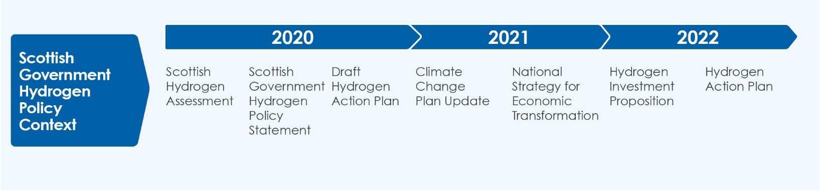
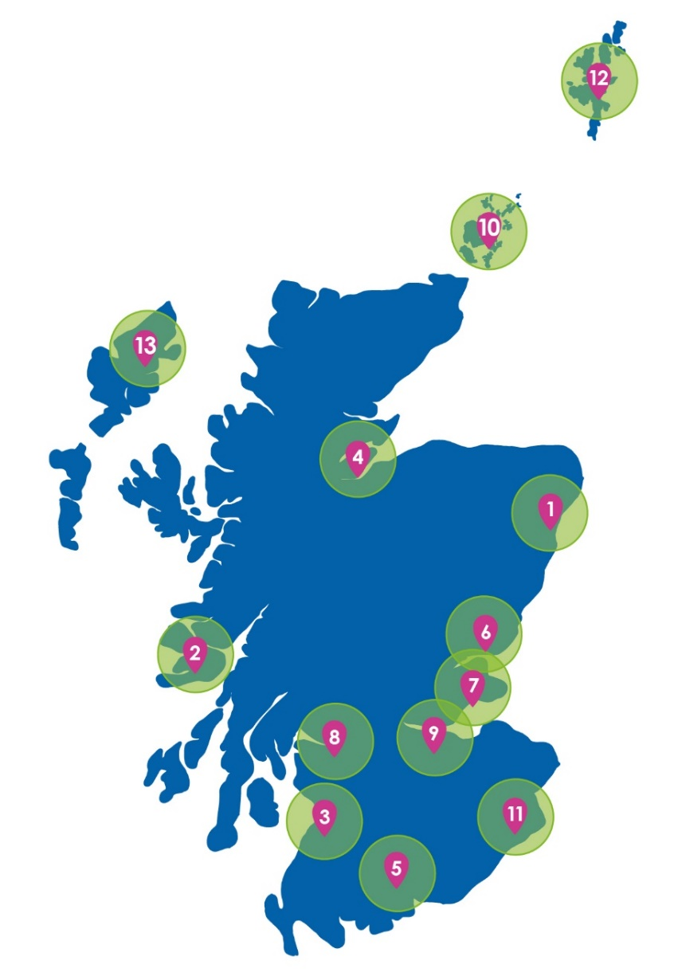
Hydrogen Policy Background
Our ambition is for Scotland to be a leading producer and exporter of hydrogen
Our 5 GW by 2030 renewable and low-carbon hydrogen ambition can be translated as approximately 0.45 Mt annually
By 2045, approximately 3.3 Mt (126 TWh) of renewable hydrogen could be produced in Scotland with approximately 2.5 Mt (94 TWh) exported to the UK and other European markets annually.
Aberdeen
Argyll & Islands
Ayrshire
Cromarty
Dumfries & Galloway
Dundee
Fife
Glasgow
Grangemouth
Orkney
Scottish Borders
Shetland
Western Isles
Scotland’s developing hydrogen Hubs
Notes:
We have committed in our Hydrogen Action Plan to develop a Hydrogen Sector Export Plan by the end of the year.
The Export Plan will outline how the Scottish Government will use its trade and investment levers to support businesses to capitalise on export opportunities across the Scottish hydrogen value chain.
We are developing our evidence base to understand Scotland’s international competitive advantage, priority export markets as well as the technical challenges for the transportation of hydrogen from Scotland to the North of Europe.

Slide 43
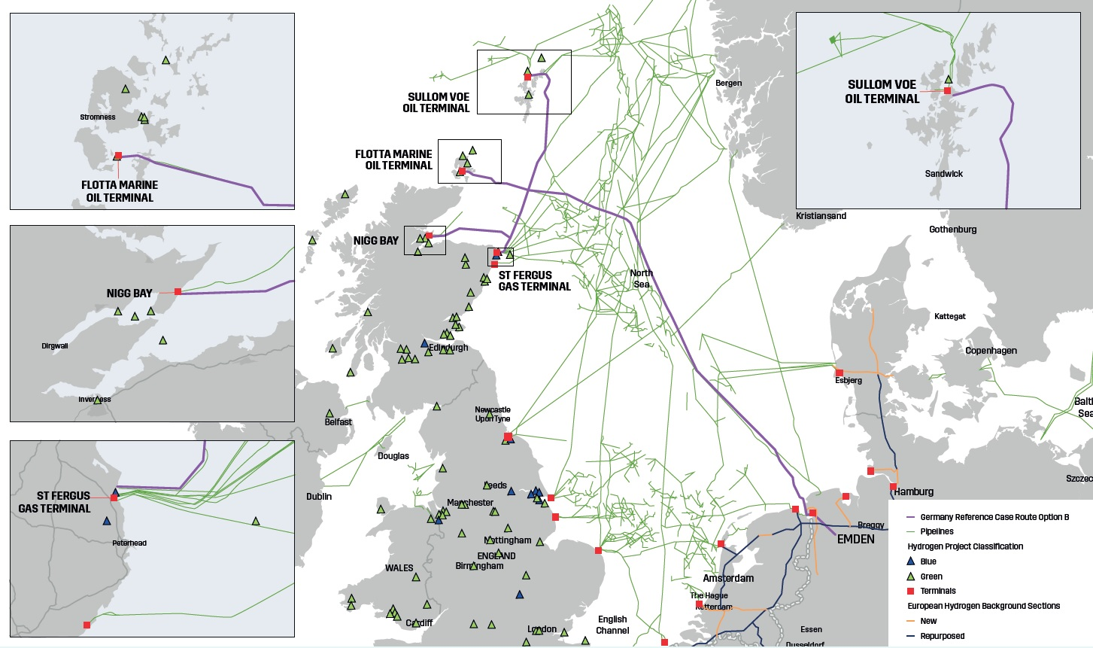
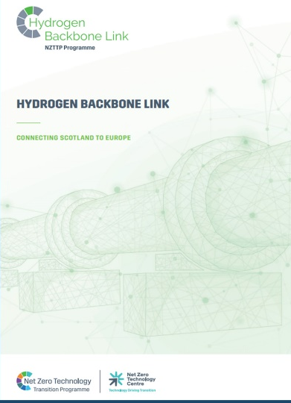
Hydrogen Backbone Link project
Net Zero Technology Centre- led concept study for new 10GW capacity offshore hydrogen pipeline across North Sea.
Shows cost-effective transportation of gaseous hydrogen direct to European markets.
Notes:
We are funding the development of the Hydrogen Backbone Link project that considers how a hydrogen pipeline network could be established between Scotland and import hubs in Europe.
The most recent of these to report is the Hydrogen Backbone Link project that considers how a hydrogen pipeline network could be established between Scotland and European import hubs, linking into the European Hydrogen Backbone.
Its report, published last month, concluded that both repurposed and new pipelines would be feasible and cost-effective in transporting large quantities of hydrogen from Scotland to centre of demands in Europe.

Slide 44
International collaboration
Strong track record of international cooperation:
  European Marine Energy Centre (EMEC) established in Orkney in 2003
  Irish Scottish Links on Energy Study (ISLES) 2010-2015
  Hywind Scotland – world’s first floating wind farm in 2017
  Surf ‘n Turf - world’s first tidal-powered hydrogen electrolyser 2017
Looking forward, Brexit a challenge of course but
  NSEC cooperation
  Clean Energy Transition Partnership programme
  Marine Spatial Planning engagement
  Co-operation agreements on H2 with partners.
Vanguard / ADMA
One of the founding members of VI 10 years ago, and we currently sit on the Board
Active in two energy pilots: ADMA energy:
  advanced manufacturing for energy related applications in harsh environments.
  Hydrogen pilot.
Notes:
Co-operation agreements on H2 with partners including German states such as BW, Hamburg, North Rhine-Westphalia or Bavaria as well as Occitania and, Denmark.

Slide 45
Key messages: Opportunity for all
With scale, offshore engineering heritage, an extensive network of ports and strong innovation clusters, Scotland will be at the heart of Europe’s energy transition, and future energy security for decades to come.
Scotland has a wealth of pioneering expertise to share with international partners, and our project pipeline offers supply chain opportunities as well as a top market for wind technologies and new port infrastructure.
To deliver the full extent of Europe’s offshore wind ambitions, collaboration and international strategic partnerships will be key.
At an international level It will take governments working together, learning together, businesses growing together, and ideas being shared between all of us to succeed.

Slide 46
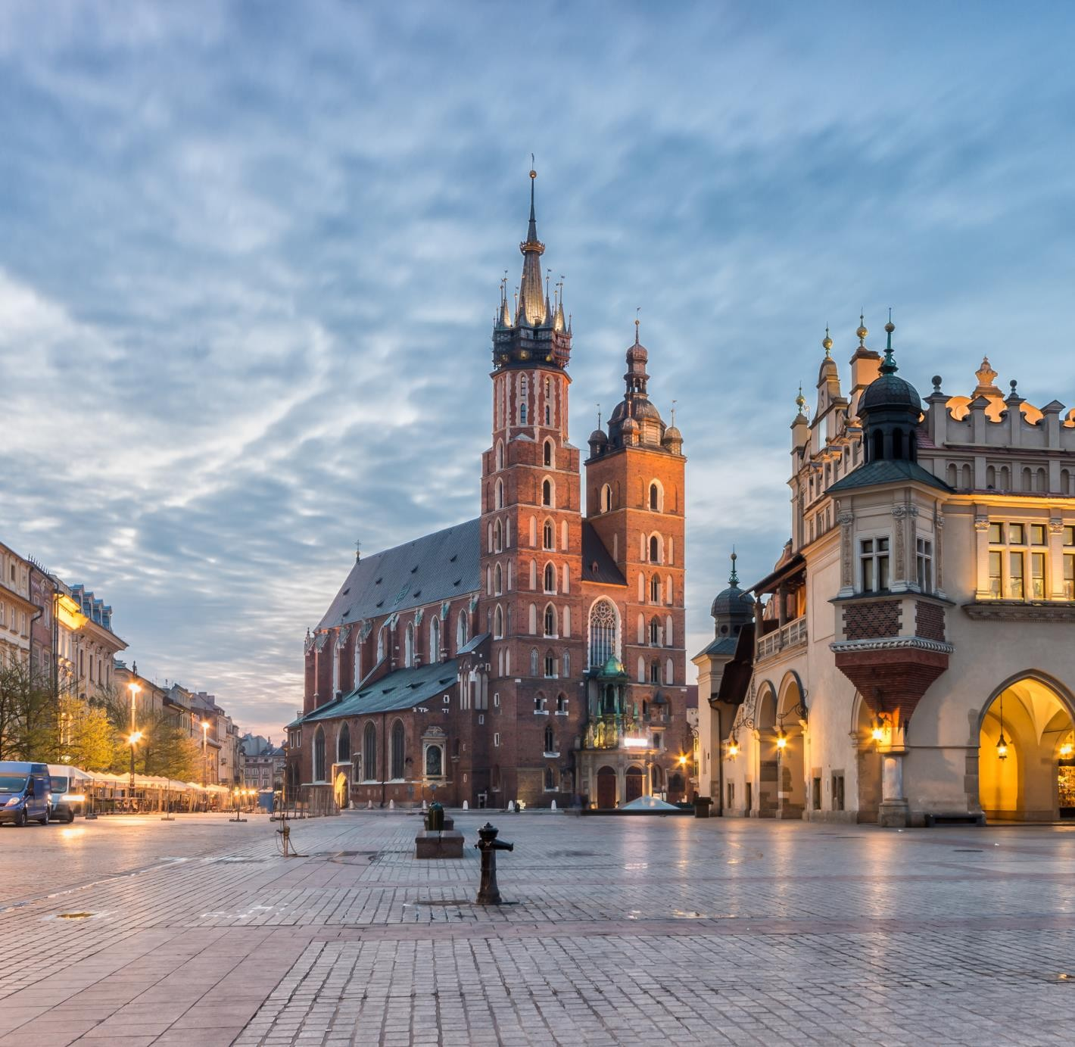
Support for the Renewable Energy Communities in Małopolska Region
Notes:
1) We will talk about the coordination and support of Małopolska entrepreneurs in the accounts of the H2 pilot project and the opinion on legislative documents proposed by the EK.
2) How participation in hydrogen activities translates into the stimulation of local ecosytems related to the smart specialisation "sustainable energy". How important it is to educate and promote clean energy sources and how this is happening in Mąopolska.
3) The role of research and local government institutions in building a coherent approach to change in response to the energy crisis, the circular economy or the need for green energy.

Slide 47
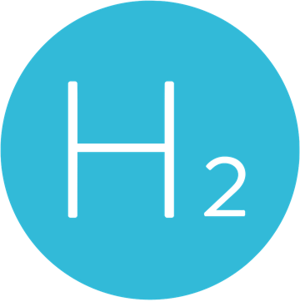











Małopolska hydrogen
technology ecosystem
industry
R&d centres
universities
100
7
8
The number of companies located in Małopolska region interested in hydrogen storage and transportation.
The number of research institutions in Małopolska region interested in hydrogen storage and transportation
The number of universities in Małopolska region interested in hydrogen storage and transportation.
Notes:
Małopolska is one of the most dynamically developing regions on the economic map of Poland and Central Europe. The region is open to new investments and
creates a friendly business environment, as well as promoting innovation. This is evidenced by the annual increase in the number of new enterprises, including
dinamically developing technology start-ups (over 455,000 operating economic entities - 4th place in Poland).
The new "Małopolska 2030" Development Strategy and the Regional Innovation Strategy of the Małopolska Region for 2030 outline the most important directions for the region's economic development in the coming years. These documents address both global trends and challenges of the changing environment as well as the potentials of the region. Among the defined priority areas, the key ones are: economy and entrepreneurship, focusing, among others, on activities related to the implementation of a closed-cycle economy model in accordance with the European Green Deal, as well as the environment. These vectors contribute to a pro-environmental approach, including in business. Innovative and sustainable development, including adaptation to climate change, is therefore the central theme of the region's development policy. Hydrogen is one of the key solutions in striving for sustainable energy and meeting the objectives related to the Green Deal for Europe. Małopolska strengthens its economic potential by creating conditions for the development of the region's priority industries, among which it is worth mentioning the chemical, sustainable energy, biotechnology, and electrical engineering sectors. Based on its potential and identified smart specializations, Małopolska is building national and international partnerships, including in the field of hydrogen technology development, such as the pilot project Hydrogen under the Vanguard Initiative.
Małopolska has significant potential in the field of scientific research and higher education. Krakow is the second largest research and development center in Poland. The region hosts 26 higher education institutions, including prestigious technical universities like the AGH University of Science and Technology and the Cracow University of Technology, which for years have been conducting research and training students in fields related to technologies focused on building an environmentally neutral economy and the use of hydrogen in energy processes. Financial expenditures for R&D place Małopolska in 2nd place in the country.
The economic potential, dynamic development of modern technologies, and infrastructural background represent the potential of Małopolska in the context of building a regional hydrogen ecosystem. The region hosts the headquarters of companies that are leaders in hydrogen production, such as Grupa Azoty S.A. and Orlen Południe S.A. Polenergia also plans to develop the hydrogen area in Małopolska in the near future. Thanks to the cooperayion of the Małopolska Transport Company S.A. with PKN Orlen, a hydrogen-powered bus is running on Krakow's roads.

Slide 48
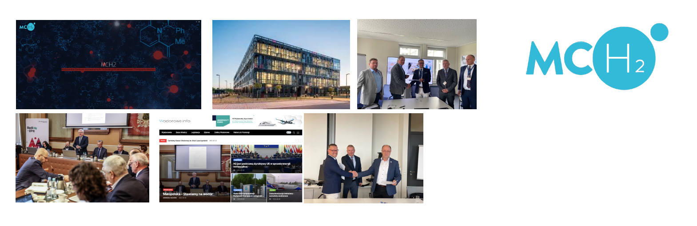
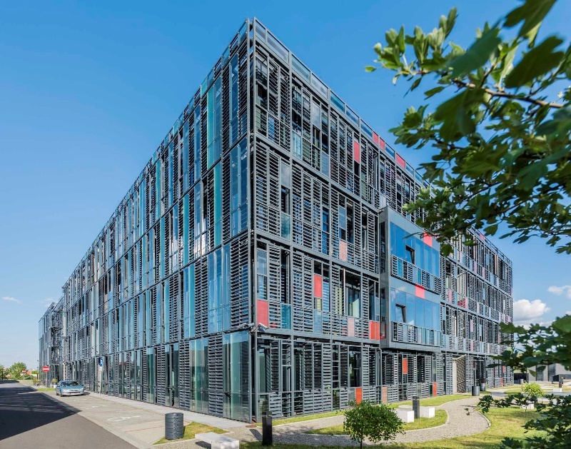




Main regional actors
Małopolska Center
for Innovative Technologies
of Hydrogen Storage
and Transport
• Hydrogen storage facilities
• Energy storage facilities
• Hydrogen production
• Electrolyzers
3 entities are the founders of the Center :
Małopolska Region
Krakow Technology Park
PhD Andrzej Czulak
Notes:
The established Małopolska Centre of Innovative Hydrogen Storage and Transport Technologies is also a response to the development opportunity diagnosed for Małopolska. It is an initiative designed to integrate actors from business, science, business support institutions and administration in supporting and developing hydrogen technologies in Małopolska.
3 entities are the founders of the Center:
- Małopolska Region
Krakow Technology Park
PhD Andrzej Czulak
In addition to integrating and networking function, the Centre intends to support local entrepreneurs who want to develop hydrogen technologies or technologies that are part of the wide-ranging hydrogen value chain. Its activity is intended not only to fulfil the assumptions of the Polish Hydrogen Strategy, but also to contribute to further strengthening the voice of Małopolska on the international arena as a real and professional partner in research and development projects. In this respect, the institution's priority role will be to acquire grants for the development of hydrogen technologies in Małopolska related to the specialisation and related fields resulting from the Centre's name.
An important area of the Centre's activity will also remain the sphere of education and promotion, consisting of making residents and potential partners aware of the beneficial changes that a switch to hydrogen technologies will bring in the long term in the context of maintaining energy security and caring for the ecosystem.

Slide 49
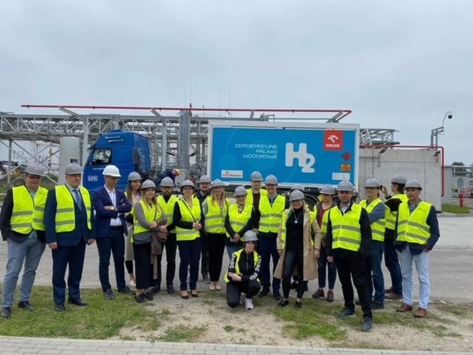
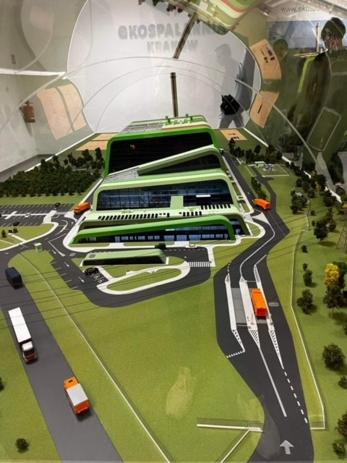
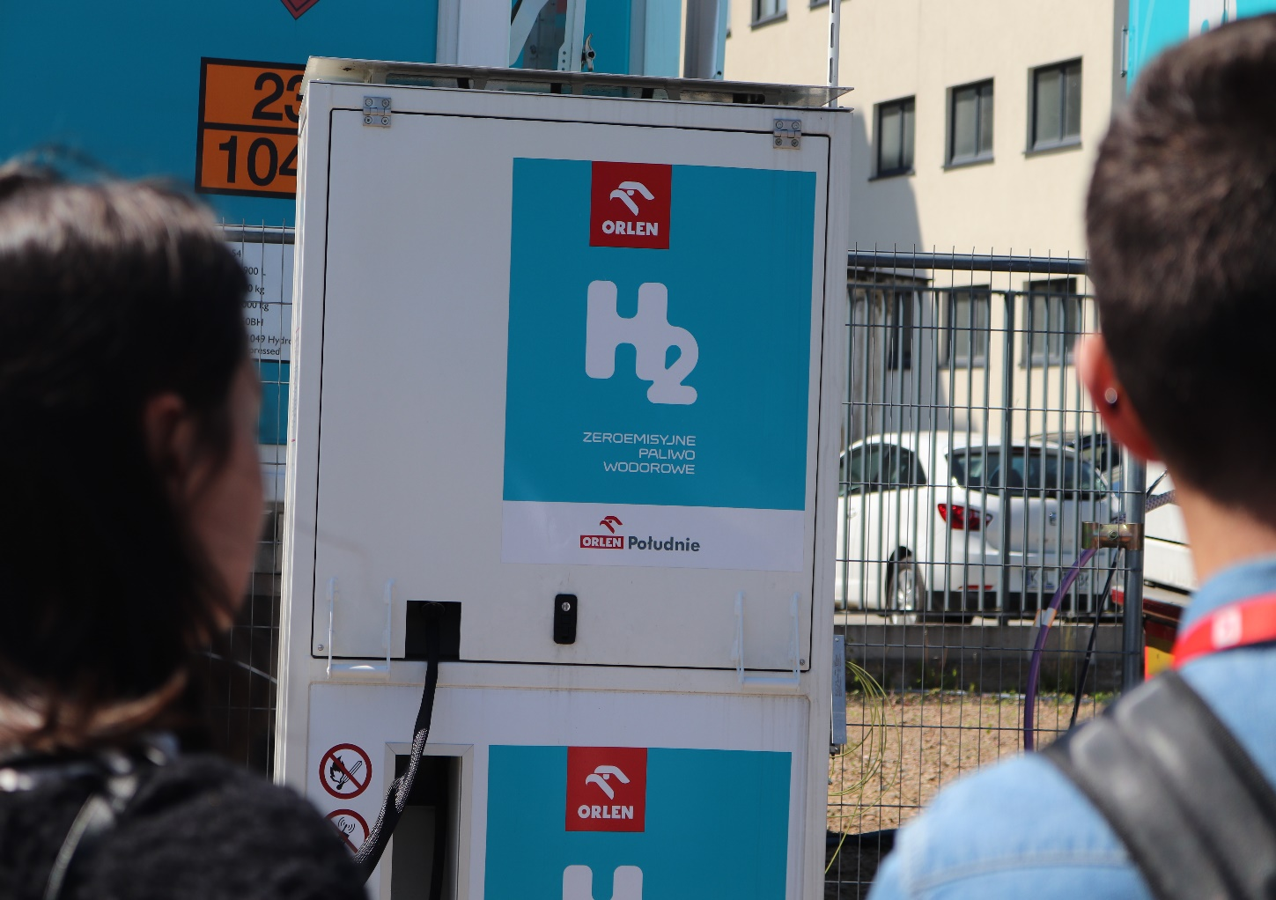
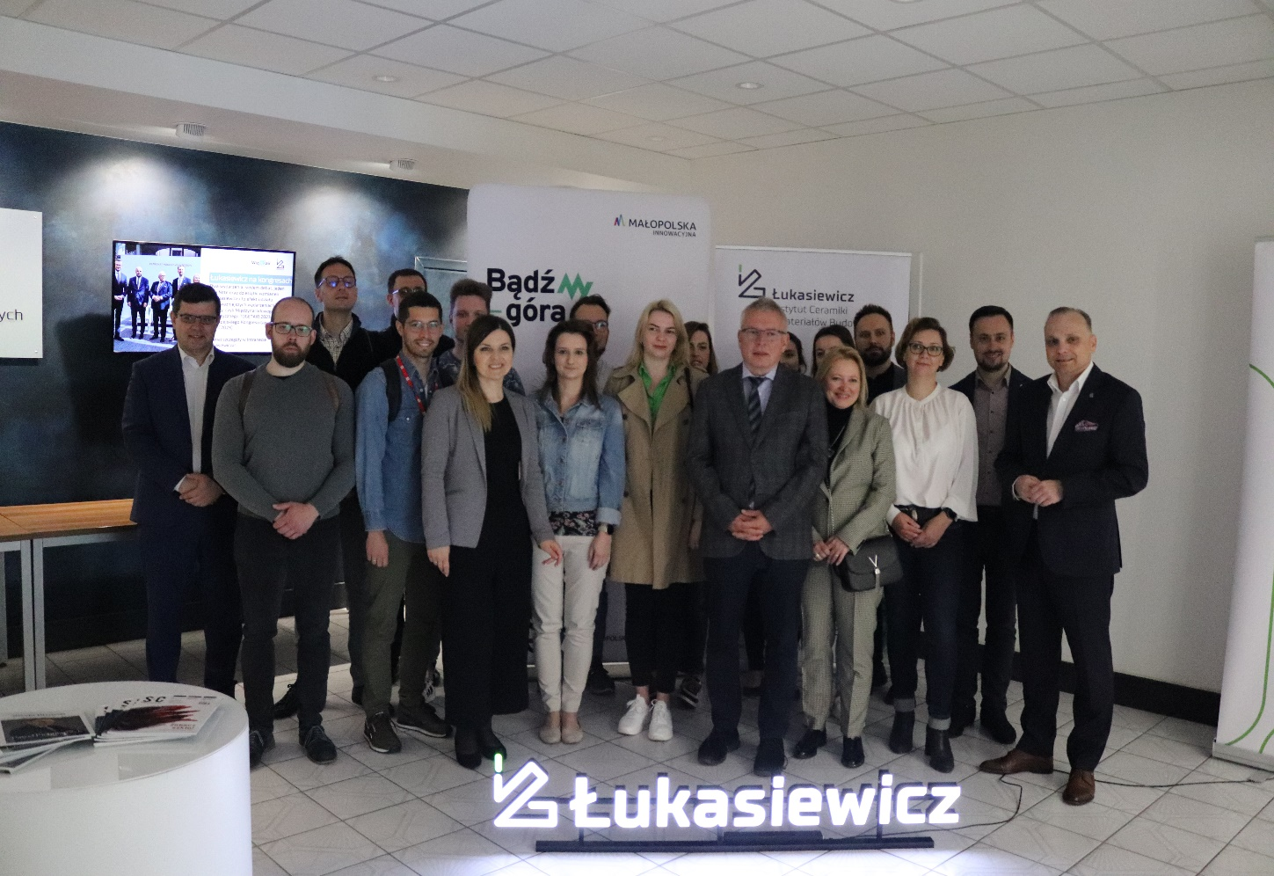
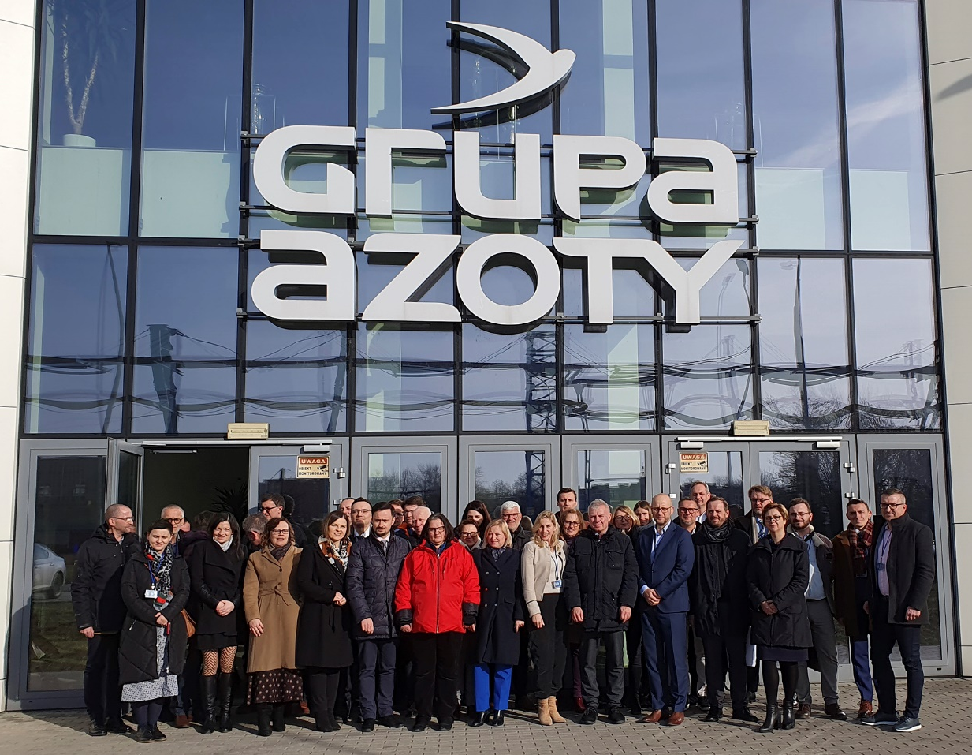

Study visits to hydrogen-utilizing companies, clean Energy Sources
Małopolska Regional Group for Development
of Hydrogen Technologies
Notes:
Małopolska is achieving new milestones on the road to building a hydrogen economy understood as: hydrogen production, storage, distribution, and utilization technologies.
There is a Małopolska Regional Group for Development of Hydrogen Technologies. The aim of establishing the this Group is to create a real platform for cooperation for the development of hydrogen technologies and to maximize both the contribution and participation in future initiatives of institutions and companies from Małopolska in this area.
Members of the Group meet regularly to exchange opinions and experiences and talk about potential joint initiatives in the field of hydrogen technology development.

Slide 50
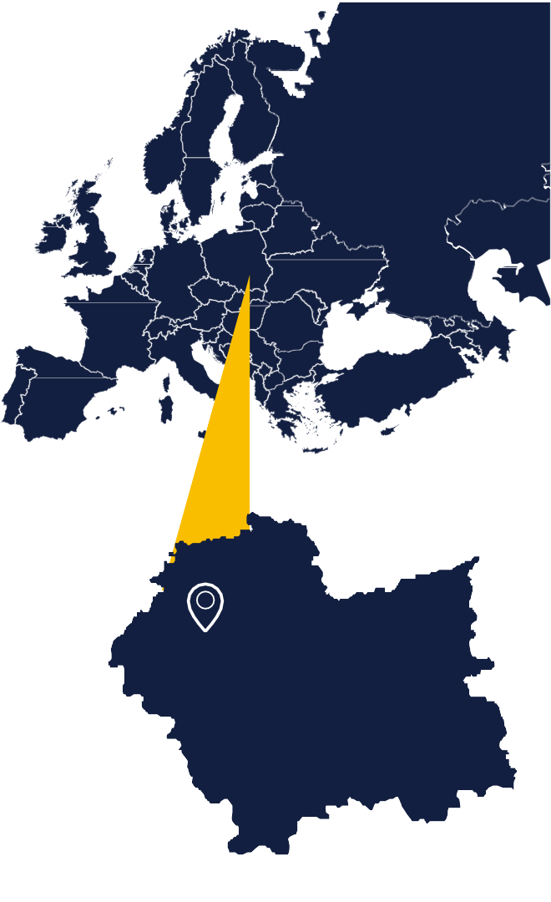

Thank you for your attention!

